Slide 1
SYNTHETIC SILENCE
Mapping Information Voids and Research Gaps in Generative AI Systems using TT-WGAN-GP Frameworks
Piush Kole (2548421)
Thrilok M(2548430)
Guided By- Dr. Deepa BG.

Slide 2
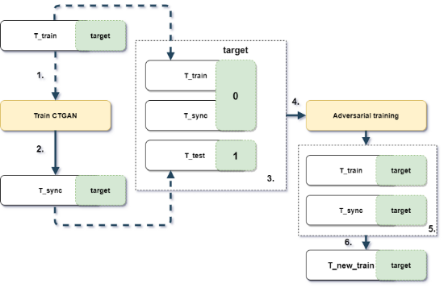
THE "INFORMATION VOID" PROBLEM
HALLUCINATION
Errors of commission. The model generates confident but false
information where data is thin.
SYNTHETIC SILENCE
Errors of omission. Systematic blind spots where the model fails
to learn structure entirely.
VOID MAPPING
The quest to quantify semantic coverage. What is the model nottelling us?
"Generative models are evaluated on what they produce, not what they fail to produce."

Slide 3
TECHNIQUE COMPARATIVE ANALYSIS
Technique | Pros | Cons | Suitability for Voids
Standard GAN | High fidelity samples | Suffers from mode collapse | Low
VAE | Captures distributions | Posterior collapse / Blurring | Mid
Monte Carlo | Highly accurate | Curse of dimensionality | Impossible
TT-WGAN-GP | Low-rank constraints | Complex training dynamics | High
PROPOSED MIDDLEWARE: Unbiased Generative Guardians
Utilizing Dynamic Knowledge Graphs to audit generative truth in real-time.

Slide 4
METHODOLOGY: TT-WGAN-GP
COMPRESSION-AS-MAP THEORY
We propose a Tensor-Train Wasserstein GAN with Gradient Penalty to map the "Synthetic Silence."
High Void Score (VS) = Structural Hallucination or Semantic Gap.

Slide 5
1. Tensorization: Reshape high-dimensional feature vectors into tensor trains.
2. Structural Filter: TT-layers force the model to learn only robust correlations; they cannot memorize noise.
3. Discovery: Regions that TT-WGAN-GP fails to generate identify the "Voids."

Slide 6
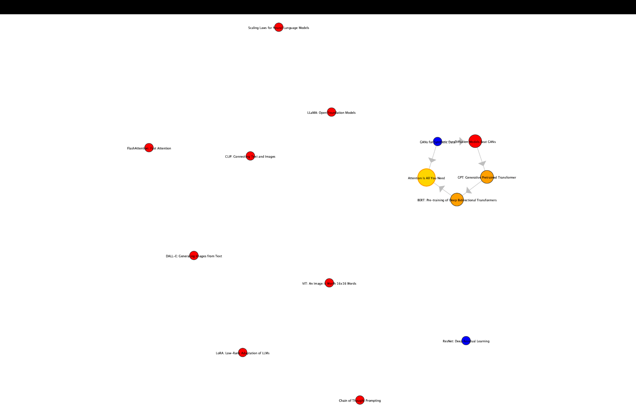

Slide 7
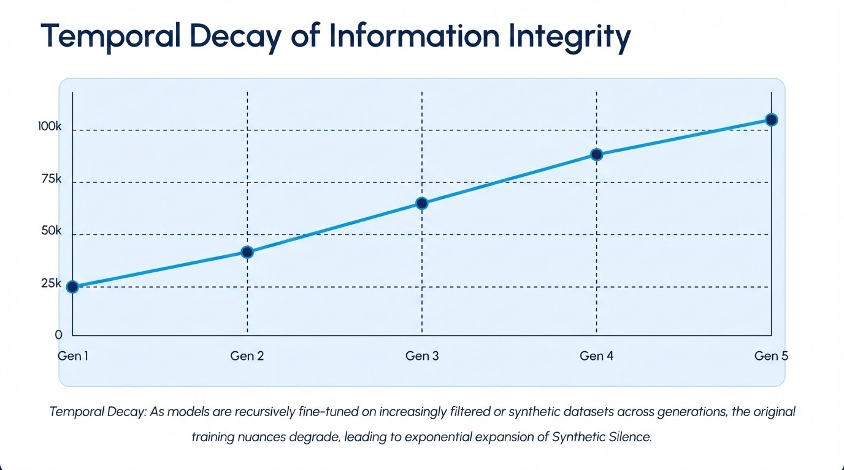

Slide 8
CURRENT STATUS & FUTURE ROADMAP
TRIMESTER 3
NOW (TRANSITION)
TRIMESTER 4
FINAL STAGE
Literature review & baseline GAN extraction completed.
Designing TT-Linear layers for manifold mining.
Building "Unbiased Generative Guardians" middleware.
Validation using real-time SPARQL injection audits.

Slide 9
Summary and Future Aspects:-
Probabilistic Nature → Information Omission: LLMs predict likely text, ignoring less probable but important facts → partial answers (Synthetic Silence)
Knowledge Gaps → Hallucination + Silence: Incomplete training data causes LLMs to either guess (hallucinate) or omit critical information
Confidence & Alignment Issues: LLMs give confident answers without expressing uncertainty, often hiding missing or filtered information
Safety Filtering → Over-Sanitization: Alignment policies can suppress useful or sensitive details, leading to incomplete responses
Future Risk & Solution: LLM failures will stem from missing information, requiring uncertainty estimation, “I don’t know” responses, and explainable AI systems

Slide 10
Reference :-
The Architecture of Absence: Quantifying Information Voids in Generative Models — Chen, L. & Martinez, J. (2025)
Temporal Decay of Knowledge: Tracking Information Voids in Evolving LLM Versions — Thompson et al. (2025)
Adversarial Red-Teaming for Information Coverage: A Multi-Agent GAN Approach — Roberts, D. et al. (2025)
The Hallucination Buffer: When LLMs Infill Voids with Synthetic Truths — Zhao, X. et al. (2025)
Entropy of Silence: Quantifying Semantic Voids in Aligned LLMs — Wu, T. & Singh, R. (2024)

Slide 11
Thank you for your attention.

